Slide 1



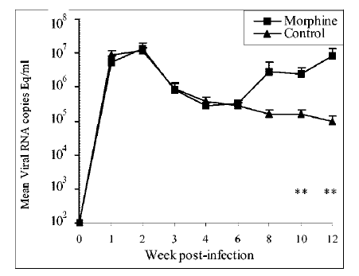
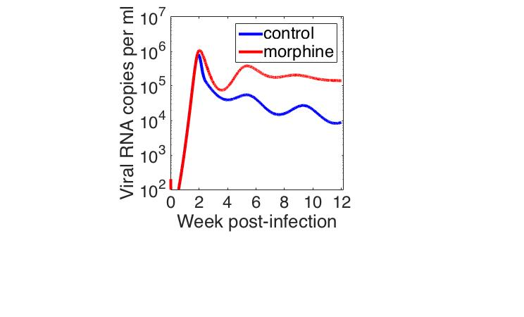
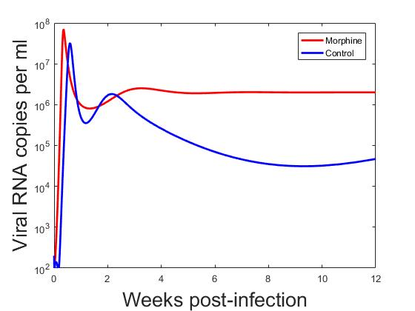
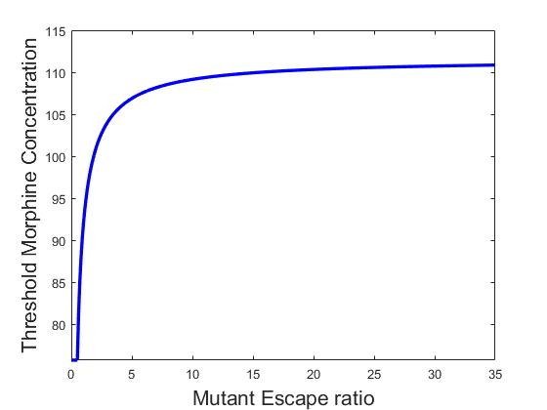
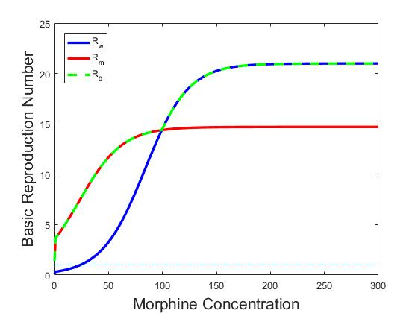
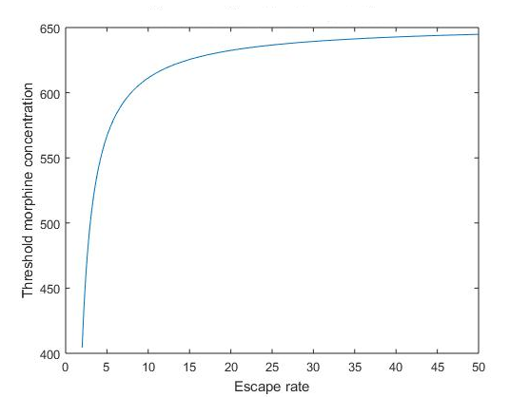
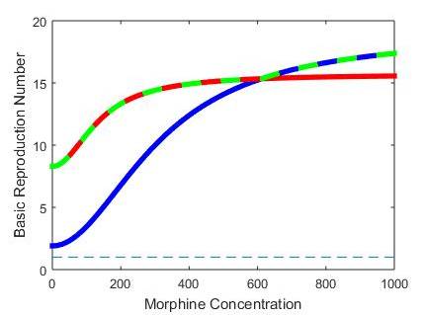
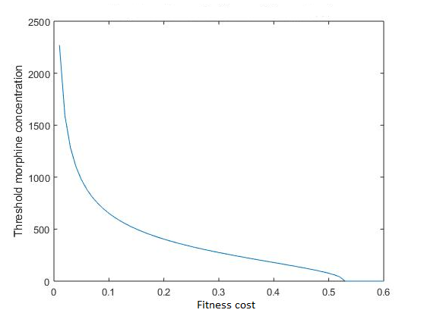
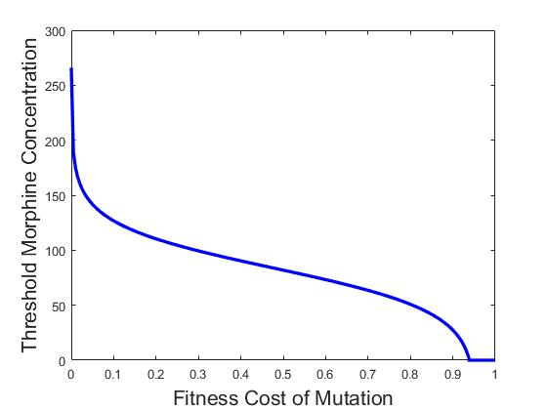
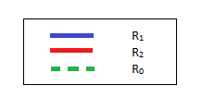
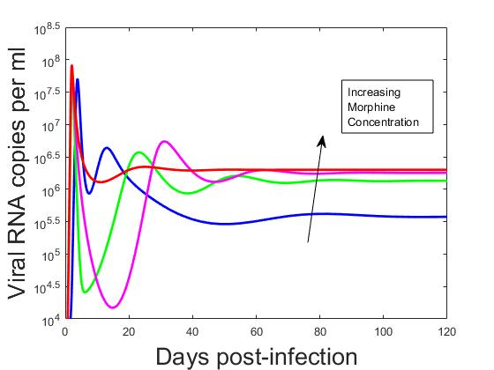
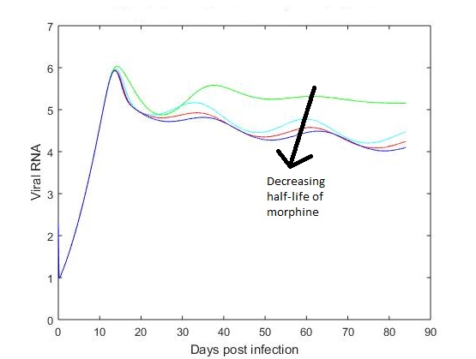
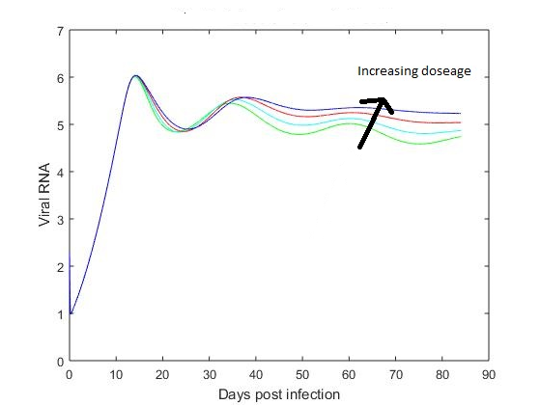
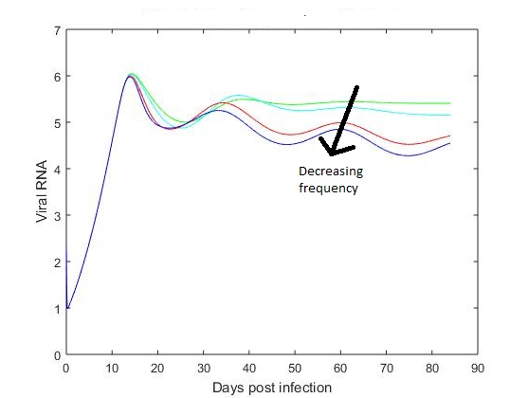
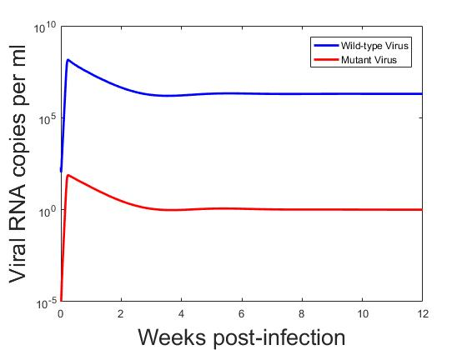
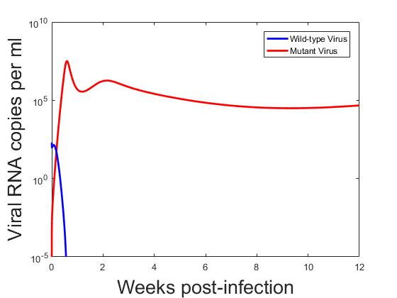

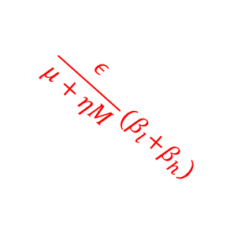







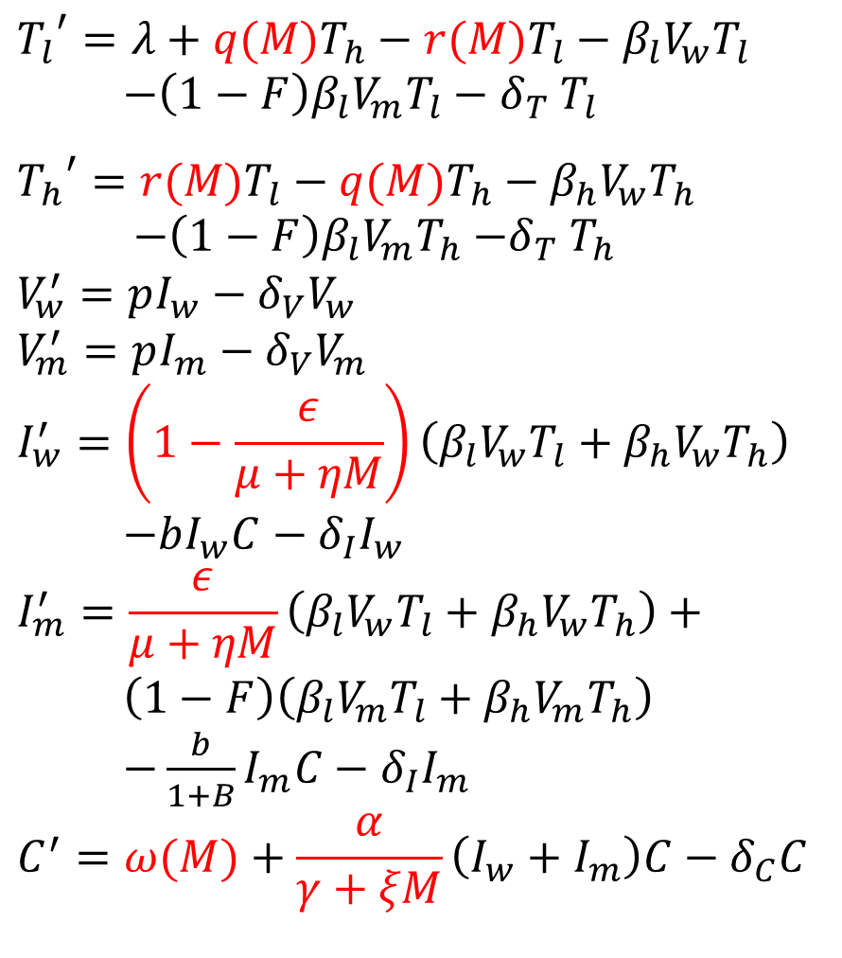

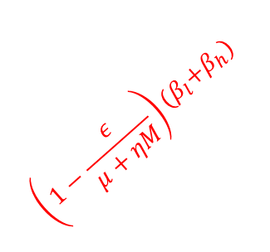


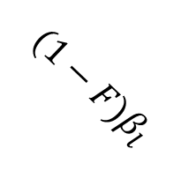





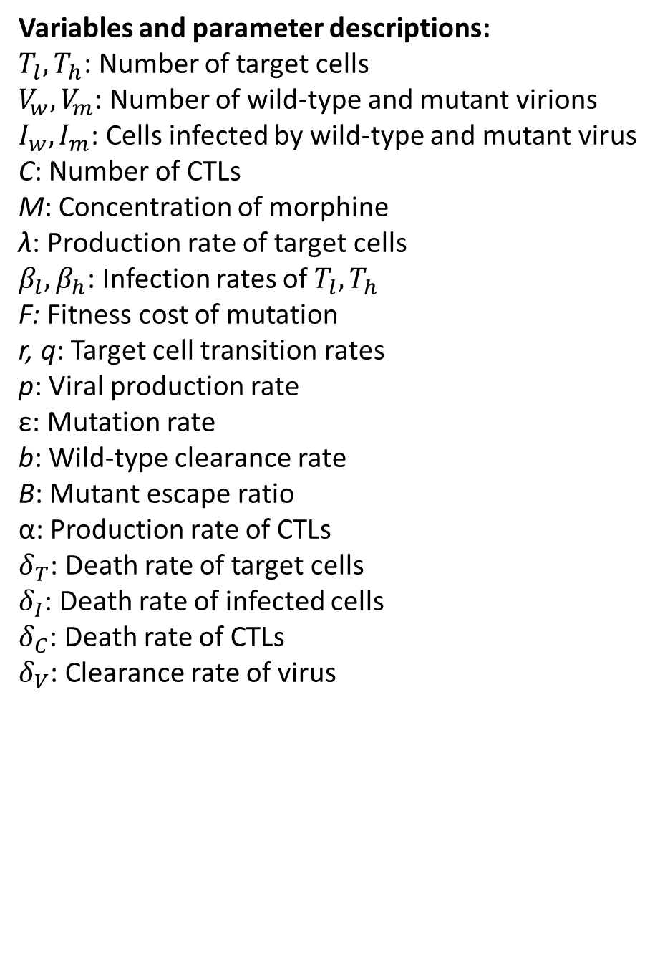

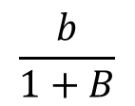
Modeling the Effects of Drugs of Abuse on HIV Infections with Two Viral Species
Peter Uhl^{1,2,3} and Naveen K. Vaidya^{1,2,3}
¹Computational Science Research Center, ²Department of Mathematics and Statistics, and ³Viral Information Institute, San Diego State University
Abstract
Background
Mathematical Model
Injection drug use is one of the greatest risk factors associated with contracting human immunodeficiency virus (HIV), and drug abusers infected with HIV suffer from a higher viral load and rapid disease progression. Replication of HIV results in a large number of mutant viruses that can escape recognition of the host’s immune response. Studies have also shown that the presence of morphine diminishes the cellular immune response, while also decreasing the viral mutation rate. In this study, we present a mathematical model to determine if the decrease in mutation and cellular immune response in the presence of morphine has an impact on the dynamics of two viral species, a wild-type and a mutant. Our model predicts that the morphine-altered mutation rate and cellular immune response allow the wild-type virus to out compete the mutant virus, resulting in a higher set-point viral load. Using the basic reproduction number derived from our model shows that the dominant viral species switches as the morphine concentration increases and crosses a threshold value, with the mutant dominating below the threshold and the wild-type dominating above it. Stability analysis and numerical simulations of the system further confirm the increased viral load associated with morphine use.
Drugs of abuse, including injection drugs, are widespread amongst people infected with HIV and the use of such drugs has been shown to significantly increase the viral load, pathogeneses, and HIV-associated Neurological Disorder (HAND) in infected individuals. Morphine, the active compound in heroin, is of particular interest because of its effect on the progression of HIV infections. Therefore, it is important to study the effects of morphine on HIV infections.
λ
$$δ_{T}$$
$$δ_{T}$$
$${T_{l}}^{′}=λ+q(M)T_{h}−r(M)T_{l}−β_{l}V_{w}T_{l}$$
$−{\left(1−F\right)β}_{l}V_{m}T_{l}−δ_{T} T_{l}$
$${T_{h}}^{′}=r(M)T_{l}−q(M)T_{h}−β_{h}V_{w}T_{h}$$
$−{\left(1−F\right)β}_{l}V_{m}T_{h}$ $−δ_{T} T_{h}$
$$V_{w}^{′}=pI_{w}−δ_{V}V_{w}$$
$$V_{m}^{′}=pI_{m}−δ_{V}V_{m}$$
$$I_{w}^{′}=\left(1−\frac{ε}{μ+ηM}\right)\left(β_{l}V_{w}T_{l}+β_{h}V_{w}T_{h}\right)$$
$−bI_{w}C−δ_{I}I_{w}$
$$I_{m}^{′}=\frac{ε}{μ+ηM}\left(β_{l}V_{w}T_{l}+β_{h}V_{w}T_{h}\right)+$$
$\left(1−F\right)\left(β_{l}V_{m}T_{l}+β_{h}V_{m}T_{h}\right)$
$−\frac{b}{1+B}I_{m}C−δ_{I}I_{m}$
$$C^{′}=ω(M)+\frac{α}{γ+ξM}\left(I_{w}+I_{m}\right)C−δ_{C}C$$
T_{l}
$$r(M)$$
T_{h}
$$q(M)$$
$$β_{l}$$
$$\frac{ε}{μ+ηM}{(β}_{l}+β_{h})$$
$${(1−F)β}_{h}$$
Experimental Evidence
$$δ_{I}$$
$$\left(1−\frac{ε}{μ+ηM}\right){(β}_{l}+β_{h})$$
$${(1−F)β}_{l}$$
$$δ_{I}$$
Drugs of abuse
Increases viral load · Lowers cellular immune responses
Increases pathogenesis · Lowers mutation rate
$$\frac{b}{1+B}$$
I_{w}
I_{m}
$$b$$
$$p$$
$$p$$
Variables and parameter descriptions:
$T_{l},T_{h}$: Number of target cells
$V_{w},V_{m}$: Number of wild-type and mutant virions
$I_{w},I_{m}$: Cells infected by wild-type and mutant virus
C: Number of CTLs
M: Concentration of morphine
λ: Production rate of target cells
$β_{l},β_{h}$: Infection rates of $T_{l},T_{h}$
F: Fitness cost of mutation
r, q: Target cell transition rates
p: Viral production rate
ε: Mutation rate
b: Wild-type clearance rate
B: Mutant escape ratio
α: Production rate of CTLs
$δ_{T}$: Death rate of target cells
$δ_{I}$: Death rate of infected cells
$δ_{C}$: Death rate of CTLs
$δ_{V}$: Clearance rate of virus
V_{w}
V_{m}
Research Question
Can the lowered immune response and mutation rate caused by the use of morphine account for the increased viral load?
$$δ_{V}$$
$$\frac{α}{γ+ξM}$$
$$δ_{V}$$
C
$$δ_{C}$$
$$ω(M)$$
Results
Model Validation:
Basic Reproduction Number:
The basic reproduction number (R₀) is the average number of infected cells that result from a single initial infected cell. It can be proved that if R₀>1 the infection persists and if R₀<1 infection dies out.
For this model: R₀ = max{R₁, R₂}, where
R₁ = (wild-type reproduction number) and
R₂ = (mutant reproduction number)
Threshold morphine concentration vs. fitness cost:
We numerically calculate the threshold morphine concentration (defined as the minimum concentration necessary for wild-type virus to dominate) as a function of the fitness cost of the mutant virus.
Threshold morphine concentration vs. escape rate:
The escape ratio, B, is a measure of how effectively the mutant virus can escape from immune responses. We simulate the threshold amount of morphine necessary for the wild-type virus to dominate as a function of the escape ratio.
Experimental Result (Kumar et al. 2004)
Model Prediction
Our model prediction agrees with the experimental data that the use of morphine results in a higher set point viral load.
Thus the lowered immune response and mutation caused by the use of morphine can explain the mechanism of the increased viral load in morphine conditioning.
R₀ is greater than 1 for any concentration of morphine, showing that the infection persists, consistent with the experimental data.
For a sufficiently high morphine concentration, the wild type will out compete the mutant; morphine causes the viral population to switch.
A lower fitness cost requires a higher threshold morphine concentration in order for the wild- type to dominate.
For a high enough fitness cost the wild-type always dominate the mutant virus.
A higher escape rate requires a higher threshold morphine concentration for the wild- type to dominate.
Effect of morphine concentration on the viral dynamics:
Individual viral populations in the absence of morphine:
Individual viral populations in the presence of morphine:
Conclusion:
The suppression of the immune response and mutation rate caused by the use of morphine results in the dominance of the wild-type virus over the mutant, thereby causing an increased viral load.
References:
Kumar et al. Journal of Virology (2004) 11425–11428
Kumar et al. Journal of Virology (2006) 354 (2006) 192–206
Konrad et al. Mathematical Population Studies, 18:122-149, 2011
Vaidya et al. Plos Comput. Biol (2016) https://doi.org/10.1371/journal.pcbi.1005127
Acknowledgements:
Dr. Anil Kumar, School of Pharmacy, UMKC
This work was supported by a STEM scholarship award funded by the National Science Foundation grant DUE- 1259951.
NSF grant DMS 1616299
NSF grant DMS-1836647
Increasing the dose of morphine increases the set-point viral load of the infection
When no morphine is present, the mutant virus dominates and the wild-type virus goes extinct
When morphine is used, the wild-type virus dominates. Due to mutation, some mutant virus is still present

